Slide 1
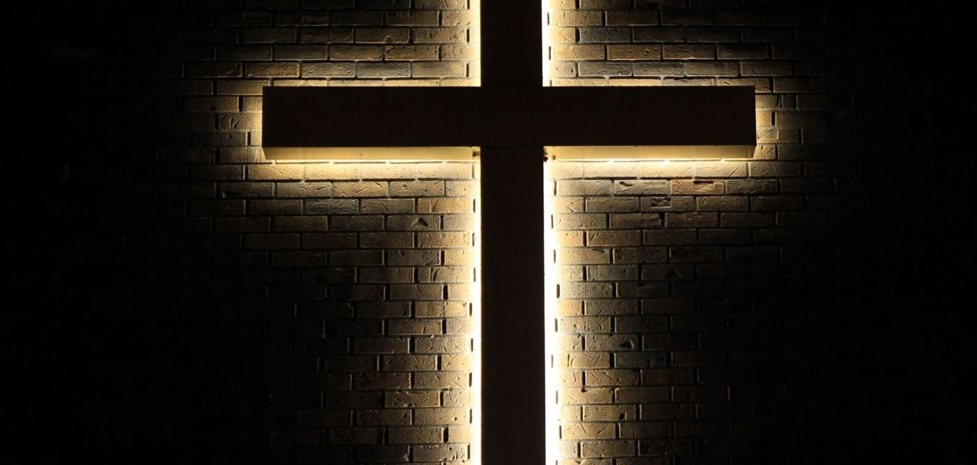


Slide 2

Part 6
The process of life in the Spirit

Slide 3
Romans 8:28-30
New International Version
28 And we know that in all things God works for the good of those who love him, who have been called according to his purpose. 29 For those God foreknew he also predestined to be conformed to the image of his Son, that he might be the firstborn among many brothers and sisters. 30 And those he predestined, he also called; those he called, he also justified; those he justified, he also glorified.

Slide 4


Slide 5
Search Assist
Google
"Life in the Spirit" refers to living in accordance with the guidance and influence of the Holy Spirit, which involves a deep personal relationship with God and a commitment to spiritual growth. This concept emphasizes the importance of being led by the Spirit in daily life, fostering transformation and empowerment through faith.

Slide 6
Life in the Spirit is a life in prayer

Slide 7
Romans 8:26-27
New International Version
26 In the same way, the Spirit helps us in our weakness. We do not know what we ought to pray for, but the Spirit himself intercedes for us through wordless groans. 27 And he who searches our hearts knows the mind of the Spirit, because the Spirit intercedes for God’s people in accordance with the will of God.

Slide 8
Grace and Faith!

Slide 9
Romans 8:28-30
New International Version
28 And we know that in all things God works for the good of those who love him, who have been called according to his purpose. 29 For those God foreknew he also predestined to be conformed to the image of his Son, that he might be the firstborn among many brothers and sisters. 30 And those he predestined, he also called; those he called, he also justified; those he justified, he also glorified.

Slide 10
More than a slogan!

Slide 11

God’s preparing us

Slide 12
The Godly process

Slide 13
The end is mentioned, but the reality is now!

Slide 14
Romans 8:28-30
New International Version
28 And we know that in all things God works for the good of those who love him, who have been called according to his purpose. 29 For those God foreknew he also predestined to be conformed to the image of his Son, that he might be the firstborn among many brothers and sisters. 30 And those he predestined, he also called; those he called, he also justified; those he justified, he also glorified.

Slide 15
This passage is more about God than us!

Slide 16
The Godly call

Slide 17
Romans 8:28-30
New International Version
28 And we know that in all things God works for the good of those who love him, who have been called according to his purpose. 29 For those God foreknew he also predestined to be conformed to the image of his Son, that he might be the firstborn among many brothers and sisters. 30 And those he predestined, he also called; those he called, he also justified; those he justified, he also glorified.

Slide 18
The Godly purpose

Slide 19
God and life’s circumstances

Slide 20
The Godly results

Slide 21
The process of life in the Spirit

Slide 22
Search Assist
Google
"Life in the Spirit" refers to living in accordance with the guidance and influence of the Holy Spirit, which involves a deep personal relationship with God and a commitment to spiritual growth. This concept emphasizes the importance of being led by the Spirit in daily life, fostering transformation and empowerment through faith.

Slide 23
The deep connection with God

