Slide 1
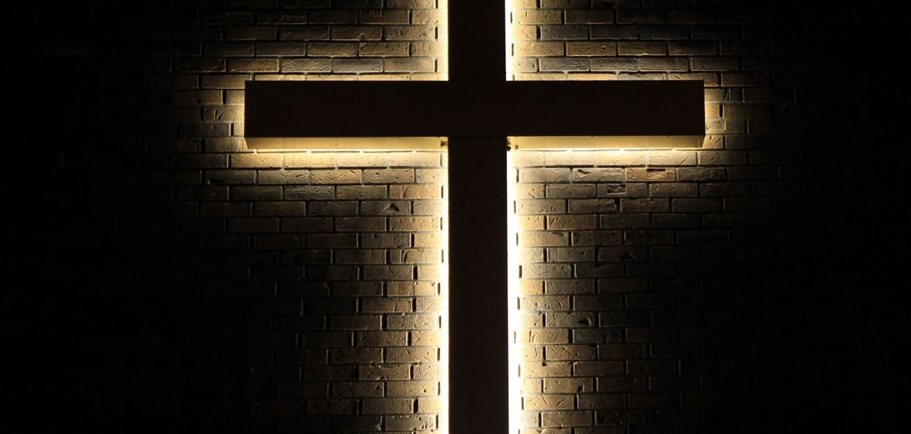


Slide 2

Part 7
The love of God in the Spirit

Slide 3
Romans 8:28-30
New International Version
28 And we know that in all things God works for the good of those who love him, who have been called according to his purpose. 29 For those God foreknew he also predestined to be conformed to the image of his Son, that he might be the firstborn among many brothers and sisters. 30 And those he predestined, he also called; those he called, he also justified; those he justified, he also glorified.

Slide 4


Slide 5
Search Assist
Google
"Life in the Spirit" refers to living in accordance with the guidance and influence of the Holy Spirit, which involves a deep personal relationship with God and a commitment to spiritual growth. This concept emphasizes the importance of being led by the Spirit in daily life, fostering transformation and empowerment through faith.

Slide 6
Grace and Faith!

Slide 7
Romans 8:31-39
New International Version
More Than Conquerors
31 What, then, shall we say in response to these things? If God is for us, who can be against us? 32 He who did not spare his own Son, but gave him up for us all—how will he not also, along with him, graciously give us all things? 33 Who will bring any charge against those whom God has chosen? It is God who justifies. 34 Who then is the one who condemns? No one. Christ Jesus who died—more than that, who was raised to life—is at the right hand of God and is also interceding for us.

Slide 8
Romans 8:31-39
New International Version
More Than Conquerors
35 Who shall separate us from the love of Christ? Shall trouble or hardship or persecution or famine or nakedness or danger or sword? 36 As it is written:
“For your sake we face death all day long;
we are considered as sheep to be slaughtered.”

Slide 9
Romans 8:31-39
New International Version
More Than Conquerors
37 No, in all these things we are more than conquerors through him who loved us. 38 For I am convinced that neither death nor life, neither angels nor demons, neither the present nor the future, nor any powers, 39 neither height nor depth, nor anything else in all creation, will be able to separate us from the love of God that is in Christ Jesus our Lord.

Slide 10

God’s seeking love

Slide 11
Romans 8:31-39
New International Version
More Than Conquerors
31 What, then, shall we say in response to these things? If God is for us, who can be against us? 32 He who did not spare his own Son, but gave him up for us all—how will he not also, along with him, graciously give us all things? 33 Who will bring any charge against those whom God has chosen? It is God who justifies. 34 Who then is the one who condemns? No one. Christ Jesus who died—more than that, who was raised to life—is at the right hand of God and is also interceding for us.

Slide 12
God’s keeping love

Slide 13
Romans 8:31-39
New International Version
More Than Conquerors
35 Who shall separate us from the love of Christ? Shall trouble or hardship or persecution or famine or nakedness or danger or sword?

Slide 14
Romans 8:31-39
New International Version
More Than Conquerors
37 No, in all these things we are more than conquerors through him who loved us. 38 For I am convinced that neither death nor life, neither angels nor demons, neither the present nor the future, nor any powers, 39 neither height nor depth, nor anything else in all creation, will be able to separate us from the love of God that is in Christ Jesus our Lord.

Slide 15
God’s completing love

Slide 16
Romans 8:31-39
New International Version
More Than Conquerors
37 No, in all these things we are more than conquerors through him who loved us. 38 For I am convinced that neither death nor life, neither angels nor demons, neither the present nor the future, nor any powers, 39 neither height nor depth, nor anything else in all creation, will be able to separate us from the love of God that is in Christ Jesus our Lord.

Slide 17
Romans 8:31-39
New International Version
More Than Conquerors
37 No, in all these things we are more than conquerors through him who loved us. 38 For I am convinced that neither death nor life, neither angels nor demons, neither the present nor the future, nor any powers, 39 neither height nor depth, nor anything else in all creation, will be able to separate us from the love of God that is in Christ Jesus our Lord.

Slide 18
The victory of God’s love!

Slide 19
The victory in God’s love!

Slide 20
The Godly purpose

Slide 21
The Godly results

Slide 22
Ephesians 3:14-20
New International Version
A Prayer for the Ephesians
14 For this reason I kneel before the Father, 15 from whom every family in heaven and on earth derives its name. 16 I pray that out of his glorious riches he may strengthen you with power through his Spirit in your inner being, 17 so that Christ may dwell in your hearts through faith. And I pray that you, being rooted and established in love,

Slide 23
Ephesians 3:14-20
New International Version
A Prayer for the Ephesians
18 may have power, together with all the Lord’s holy people, to grasp how wide and long and high and deep is the love of Christ, 19 and to know this love that surpasses knowledge—that you may be filled to the measure of all the fullness of God.
20 Now to him who is able to do immeasurably more than all we ask or imagine, according to his power that is at work within us,

Slide 24
Search Assist
Google
"Life in the Spirit" refers to living in accordance with the guidance and influence of the Holy Spirit, which involves a deep personal relationship with God and a commitment to spiritual growth. This concept emphasizes the importance of being led by the Spirit in daily life, fostering transformation and empowerment through faith.

Slide 25
Fully realize the love of God in your life

