Slide 1
The Touch of God’s Hand

Slide 2
Psalm 37:1-11 New International Version 1 Do not fret because of those who are evil or be envious of those who do wrong; 2 for like the grass they will soon wither, like green plants they will soon die away. 3 Trust in the Lord and do good; dwell in the land and enjoy safe pasture. 4 Take delight in the Lord, and he will give you the desires of your heart.

Slide 3
Psalm 37:1-11 New International Version 5 Commit your way to the Lord; trust in him and he will do this: 6 He will make your righteous reward shine like the dawn, your vindication like the noonday sun. 7 Be still before the Lord and wait patiently for him; do not fret when people succeed in their ways, when they carry out their wicked schemes.

Slide 4
Psalm 37:1-11 New International Version 8 Refrain from anger and turn from wrath; do not fret—it leads only to evil. 9 For those who are evil will be destroyed, but those who hope in the Lord will inherit the land. 10 A little while, and the wicked will be no more; though you look for them, they will not be found.

Slide 5
Psalm 37:1-11 New International Version 11 But the meek will inherit the land and enjoy peace and prosperity.

Slide 6
Psalm 37:23-28 New International Version 23 The Lord makes firm the steps of the one who delights in him; 24 though he may stumble, he will not fall, for the Lord upholds him with his hand.

Slide 7
Romans 8:28 New International Version 28 And we know that in all things God works for the good of those who love him, who have been called according to his purpose.

Slide 8
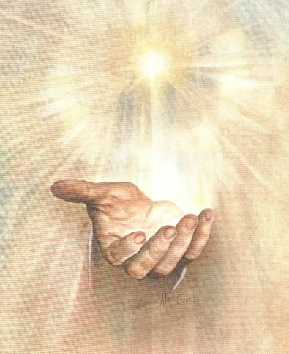
The Lifting Hand of God

Slide 9
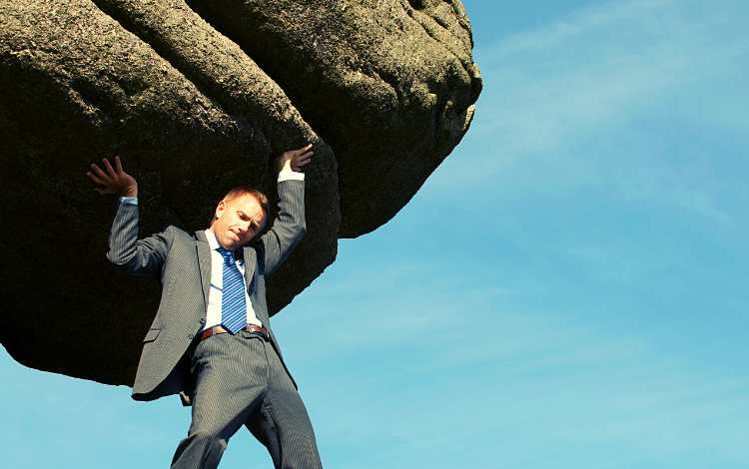
God’s touch can lift the burdens we are trying to carry

Slide 10
God’s touch can lift the burdens we are trying to carry

Slide 11
1 Peter 5:6-7 New International Version 6 Humble yourselves, therefore, under God’s mighty hand, that he may lift you up in due time. 7 Cast all your anxiety on him because he cares for you.

Slide 12
1 Peter 5:6-7 New Life Version 6 So put away all pride from yourselves. You are standing under the powerful hand of God. At the right time He will lift you up. 7 Give all your worries to Him because He cares for you.

Slide 13
God’s touch can lift the burdens we are trying to carry

Slide 14
When we turn over our burdens to the Lord he will lift us up

Slide 15
I truly believe provides us with everything we need

Slide 16
Psalm 37:25 New International Version 25 I was young and now I am old, yet I have never seen the righteous forsaken or their children begging bread.

Slide 17
God’s hand is providing all the time in all kinds of ways. Some folks can’t see this… Why?

Slide 18
Worry blinds us from seeing the God’s hand of provision at work

Slide 19
1 Peter 5:6-7 New Life Version 6 So put away all pride from yourselves. You are standing under the powerful hand of God. At the right time He will lift you up. 7 Give all your worries to Him because He cares for you.

Slide 20
Trust and Rest Are the key to God’s Guiding Hand Psalm 37:1-9

Slide 21
Psalm 37:5-7 New International Version 5 Commit your way to the Lord; trust in him and he will do this: 6 He will make your righteous reward shine like the dawn, your vindication like the noonday sun. 7 Be still before the Lord and wait patiently for him; do not fret when people succeed in their ways, when they carry out their wicked schemes.

Slide 22
Psalm 37:23-28 New International Version 23 The Lord makes firm the steps of the one who delights in him; 24 though he may stumble, he will not fall, for the Lord upholds him with his hand.

Slide 23
Psalm 37:23-28 New International Version 25 I was young and now I am old, yet I have never seen the righteous forsaken or their children begging bread. 26 They are always generous and lend freely; their children will be a blessing.

Slide 24
Psalm 37:23-28 New International Version 27 Turn from evil and do good; then you will dwell in the land forever. 28 For the Lord loves the just and will not forsake his faithful ones. Wrongdoers will be completely destroyed; the offspring of the wicked will perish.

Slide 25
We’re always asking God to come close and touch us. He is calling us to come near to Him. James 4:6-10

Slide 26
James 4:7-8 New International Version 7 Submit yourselves, then, to God. Resist the devil, and he will flee from you. 8 Come near to God and he will come near to you. Wash your hands, you sinners, and purify your hearts, you double-minded.

