Slide 1

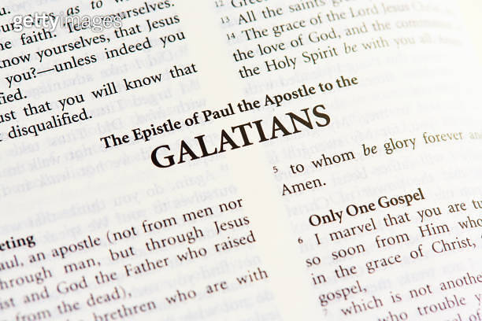
Galatians 5 Part 4
Real Freedom In Christ

Slide 2



Slide 3
Galatians 5:1-6
Contemporary English Version
Christ Gives Freedom
1 Christ has set us free! This means we are really free. Now hold on to your freedom and don't ever become slaves of the Law again.
4 And if you try to please God by obeying the Law, you have cut yourself off from Christ and his gift of undeserved grace.

Slide 4
Galatians 5:13-18
New International Version
Life by the Spirit
13 You, my brothers and sisters, were called to be free. But do not use your freedom to indulge the flesh; rather, serve one another humbly in love. 14 For the entire law is fulfilled in keeping this one command: “Love your neighbor as yourself.” 15 If you bite and devour each other, watch out or you will be destroyed by each other.

Slide 5
John 13:34-35
New International Version
34 “A new command I give you: Love one another. As I have loved you, so you must love one another. 35 By this everyone will know that you are my disciples, if you love one another.”

Slide 6
Romans 13:8-10
New International Version
Love Fulfills the Law
8 Let no debt remain outstanding, except the continuing debt to love one another, for whoever loves others has fulfilled the law. 9 The commandments, “You shall not commit adultery,” “You shall not murder,” “You shall not steal,” “You shall not covet,” and whatever other command there may be, are summed up in this one command: “Love your neighbor as yourself.” 10 Love does no harm to a neighbor. Therefore love is the fulfillment of the law.

Slide 7
Galatians 5:13-18
New International Version
Life by the Spirit
16 So I say, walk by the Spirit, and you will not gratify the desires of the flesh. 17 For the flesh desires what is contrary to the Spirit, and the Spirit what is contrary to the flesh. They are in conflict with each other, so that you are not to do whatever you want. 18 But if you are led by the Spirit, you are not under the law.

Slide 8
Search Assist
Google
"Life in the Spirit" refers to living in accordance with the guidance and influence of the Holy Spirit, which involves a deep personal relationship with God and a commitment to spiritual growth. This concept emphasizes the importance of being led by the Spirit in daily life, fostering transformation and empowerment through faith.

Slide 9
Galatians 5:19-26
New International Version
19 The acts of the flesh are obvious: sexual immorality, impurity and debauchery; 20 idolatry and witchcraft; hatred, discord, jealousy, fits of rage, selfish ambition, dissensions, factions 21 and envy; drunkenness, orgies, and the like. I warn you, as I did before, that those who live like this will not inherit the kingdom of God.

Slide 10
Galatians 5:19-26
New International Version
22 But the fruit of the Spirit is love, joy, peace, forbearance, kindness, goodness, faithfulness, 23 gentleness and self-control. Against such things there is no law. 24 Those who belong to Christ Jesus have crucified the flesh with its passions and desires. 25 Since we live by the Spirit, let us keep in step with the Spirit. 26 Let us not become conceited, provoking and envying each other.

Slide 11
Galatians 5:19-26 Living Bible
19 But when you follow your own wrong inclinations, your lives will produce these evil results: impure thoughts, eagerness for lustful pleasure, 20 idolatry, spiritism (that is, encouraging the activity of demons), hatred and fighting, jealousy and anger, constant effort to get the best for yourself, complaints and criticisms, the feeling that everyone else is wrong except those in your own little group—and there will be wrong doctrine,

Slide 12
Galatians 5:19-26 Living Bible
21 envy, murder, drunkenness, wild parties, and all that sort of thing. Let me tell you again, as I have before, that anyone living that sort of life will not inherit the Kingdom of God.
22 But when the Holy Spirit controls our lives he will produce this kind of fruit in us: love, joy, peace, patience, kindness, goodness, faithfulness, 23 gentleness and self-control; and here there is no conflict with Jewish laws.

Slide 13
Galatians 5:19-26 Living Bible
24 Those who belong to Christ have nailed their natural evil desires to his cross and crucified them there.
25 If we are living now by the Holy Spirit’s power, let us follow the Holy Spirit’s leading in every part of our lives. 26 Then we won’t need to look for honors and popularity, which lead to jealousy and hard feelings.

Slide 14

Point 1
Bad Production

Slide 15
Galatians 5:19-21
New International Version
19 The acts of the flesh are obvious: sexual immorality, impurity and debauchery; 20 idolatry and witchcraft; hatred, discord, jealousy, fits of rage, selfish ambition, dissensions, factions 21 and envy; drunkenness, orgies, and the like. I warn you, as I did before, that those who live like this will not inherit the kingdom of God.

Slide 16
Galatians 5:19-21 Living Bible
19 But when you follow your own wrong inclinations, your lives will produce these evil results: impure thoughts, eagerness for lustful pleasure, 20 idolatry, spiritism (that is, encouraging the activity of demons), hatred and fighting, jealousy and anger, constant effort to get the best for yourself, complaints and criticisms, the feeling that everyone else is wrong except those in your own little group—and there will be wrong doctrine,

Slide 17
Galatians 5:19-21 Living Bible
21 envy, murder, drunkenness, wild parties, and all that sort of thing. Let me tell you again, as I have before, that anyone living that sort of life will not inherit the Kingdom of God.

Slide 18
Point 2
Good Production

Slide 19
Galatians 5:22-23
New International Version
22 But the fruit of the Spirit is love, joy, peace, forbearance, kindness, goodness, faithfulness, 23 gentleness and self-control. Against such things there is no law.

Slide 20
Galatians 5:19-26 Living Bible
22 But when the Holy Spirit controls our lives he will produce this kind of fruit in us: love, joy, peace, patience, kindness, goodness, faithfulness, 23 gentleness and self-control; and here there is no conflict with Jewish laws.

Slide 21
Point 3
What Others Experience In Us

Slide 22
Galatians 5:22-23
New International Version
22 But the fruit of the Spirit is love, joy, peace, forbearance, kindness, goodness, faithfulness, 23 gentleness and self-control. Against such things there is no law.

Slide 23
Galatians 5:19-26 Living Bible
22 But when the Holy Spirit controls our lives he will produce this kind of fruit in us: love, joy, peace, patience, kindness, goodness, faithfulness, 23 gentleness and self-control; and here there is no conflict with Jewish laws.

Slide 24
Point 4
See God…not me

Slide 25
Galatians 5:22-25
New International Version
22 But the fruit of the Spirit is love, joy, peace, forbearance, kindness, goodness, faithfulness, 23 gentleness and self-control. Against such things there is no law. 24 Those who belong to Christ Jesus have crucified the flesh with its passions and desires. 25 Since we live by the Spirit, let us keep in step with the Spirit.

Slide 26
Galatians 2:19-21
New International Version
19 “For through the law I died to the law so that I might live for God. 20 I have been crucified with Christ and I no longer live, but Christ lives in me. The life I now live in the body, I live by faith in the Son of God, who loved me and gave himself for me. 21 I do not set aside the grace of God, for if righteousness could be gained through the law, Christ died for nothing!”

