Slide 1

Who Is Jesus Christ?
21 Portraits of Christ from the book of John

Slide 2
Each chapter in the book John contains a portrayal of some aspect of the character or work of Christ
John 20:31 NIV
³¹But these are written that you may believe that Jesus is the Christ, the Son of God, and that by believing you may have life in his name.

Slide 3

What is the most important question in life?

Slide 4

Who is Jesus Christ?

Slide 5
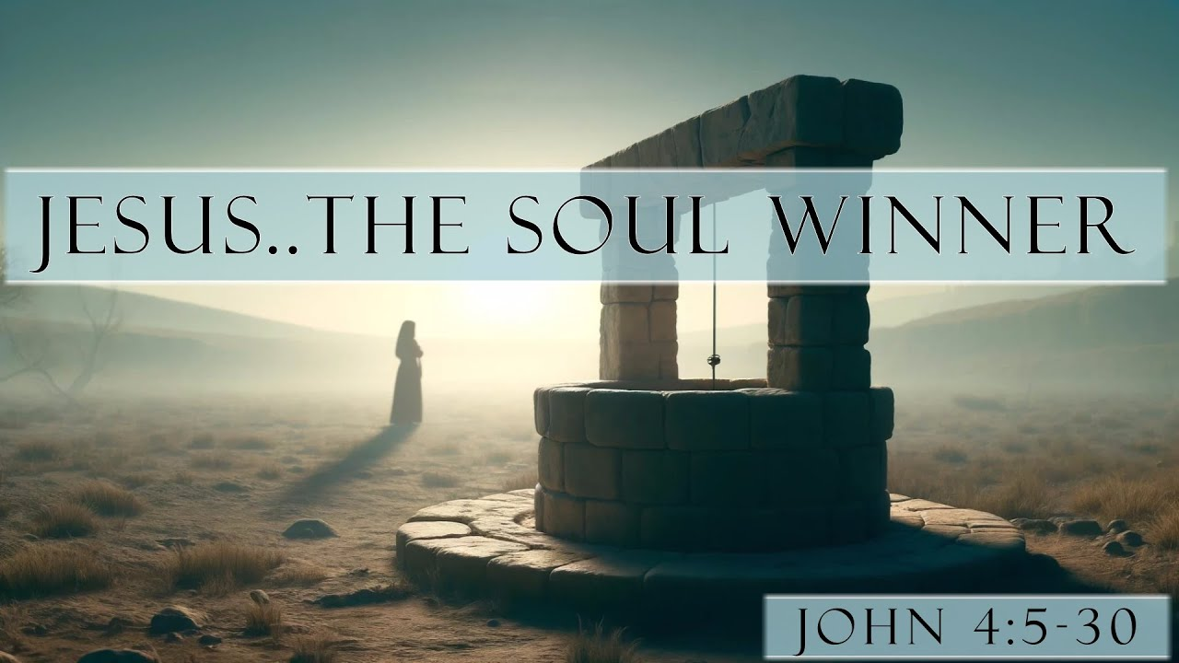
1. Son of God
2. Son of Man
3. Divine Teacher

Slide 6
Soul-Winner
John 4:7-29
His mission is portrayed

Slide 7
John 4:7-29 NIV
⁷ When a Samaritan woman came to draw water, Jesus said to her, “Will you give me a drink?” ⁸ (His disciples had gone into the town to buy food.)
⁹ The Samaritan woman said to him, “You are a Jew and I am a Samaritan woman. How can you ask me for a drink?” (For Jews do not associate with Samaritans.)

Slide 8
John 4:7-29 NIV
¹⁰ Jesus answered her, “If you knew the gift of God and who it is that asks you for a drink, you would have asked him and he would have given you living water.”

Slide 9
John 4:7-29 NIV
¹¹ “Sir,” the woman said, “you have nothing to draw with and the well is deep. Where can you get this living water? ¹² Are you greater than our father Jacob, who gave us the well and drank from it himself, as did also his sons and his livestock?”

Slide 10
John 4:7-29 NIV
¹³ Jesus answered, “Everyone who drinks this water will be thirsty again,¹⁴ but whoever drinks the water I give them will never thirst. Indeed, the water I give them will become in them a spring of water welling up to eternal life.”

Slide 11
John 4:7-29 (IV
¹⁵ The woman said to him, “Sir, give me this water so that I won’t get thirsty and have to keep coming here to draw water.”
¹⁶ He told her, “Go, call your husband and come back.”
¹⁷ “I have no husband,” she replied.

Slide 12
John 4:7-29 NIV
Jesus said to her, “You are right when you say you have no husband.¹⁸ The fact is, you have had five husbands, and the man you now have is not your husband. What you have just said is quite true.”
¹⁹ “Sir,” the woman said, “I can see that you are a prophet.

Slide 13
John 4:7-29 NIV
²⁰ Our ancestors worshiped on this mountain, but you Jews claim that the place where we must worship is in Jerusalem.”
²¹ “Woman,” Jesus replied, “believe me, a time is coming when you will worship the Father neither on this mountain nor in Jerusalem.

Slide 14
John 4:7-29 NIV
²² You Samaritans worship what you do not know; we worship what we do know, for salvation is from the Jews. ²³ Yet a time is coming and has now come when the true worshipers will worship the Father in the Spirit and in truth, for they are the kind of worshipers the Father seeks.

Slide 15
John 4:7-29 NIV
²⁴ God is spirit, and his worshipers must worship in the Spirit and in truth.”

Slide 16
John 4:7-29 NIV
²⁵ The woman said, “I know that Messiah” (called Christ) “is coming. When he comes, he will explain everything to us.”
²⁶ Then Jesus declared, “I, the one speaking to you—I am he.”

Slide 17
John 4:7-29 NIV
²⁷ Just then his disciples returned and were surprised to find him talking with a woman. But no one asked, “What do you want?” or “Why are you talking with her?”

Slide 18
John 4:7-29 NIV
²⁸ Then, leaving her water jar, the woman went back to the town and said to the people, ²⁹ “Come, see a man who told me everything I ever did. Could this be the Messiah?”

Slide 19

John 4:7-29
Thirsty souls-our view of things vs. 7-29
Jesus offers living water vs. 7-29
A satisfied soul vs. 7-29

Slide 20
John 4:7-29 NIV
¹³ Jesus answered, “Everyone who drinks this water will be thirsty again,¹⁴ but whoever drinks the water I give them will never thirst. Indeed, the water I give them will become in them a spring of water welling up to eternal life.”

Slide 21
John 4:7-29 NIV
²⁵ The woman said, “I know that Messiah” (called Christ) “is coming. When he comes, he will explain everything to us.”
²⁶ Then Jesus declared, “I, the one speaking to you—I am he.”

Slide 22


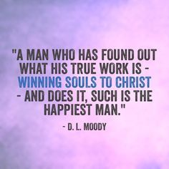

Slide 24
John 7:37-39 NIV
37 On the last and greatest day of the festival, Jesus stood and said in a loud voice, “Let anyone who is thirsty come to me and drink. 38 Whoever believes in me, as Scripture has said, rivers of living water will flow from within them

Slide 25
John 7:37-39 NIV
39 By this he meant the Spirit, whom those who believed in him were later to receive. Up to that time the Spirit had not been given, since Jesus had not yet been glorified.

Slide 26
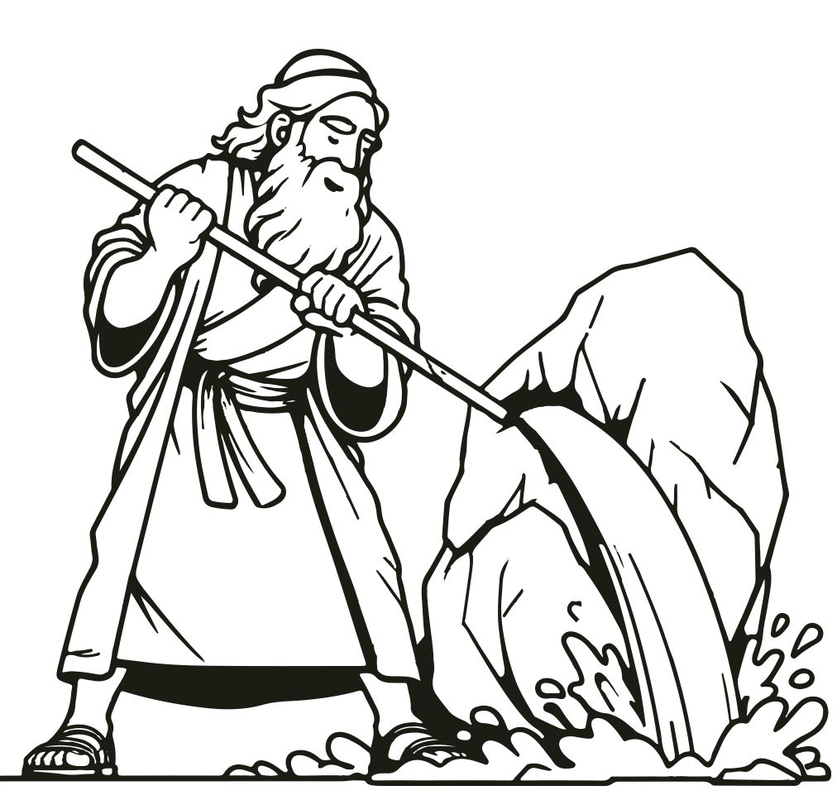
Meribah…
Quarrelling
Massah…
Testing

Slide 27
The water-giving rock is used as a symbol of Christ in 1 Corinthians 10:4. The rock was struck in Exodus 17:6, just like Christ was crucified once (Hebrews 7:27). Moses’ speaking to the rock in Numbers 20 could have been meant as a picture of prayer. Jesus was “struck” once, and He continues to provide living water to those who pray in faith to Him. When Moses angrily struck the rock, he destroyed the biblical typology and, in effect, crucified Christ again.

Slide 28
John 20:31 (NIV)
³¹But these are written that you may believe that Jesus is the Christ, the Son of God, and that by believing you may have life in his name.

Slide 29
John 4:39-42 NIV
Many Samaritans Believe
39 Many of the Samaritans from that town believed in him because of the woman’s testimony, “He told me everything I ever did.” 40 So when the Samaritans came to him, they urged him to stay with them, and he stayed two days. 41 And because of his words many more became believers.
42 They said to the woman, “We no longer believe just because of what you said; now we have heard for ourselves, and we know that this man really is the Savior of the world.”

Slide 30
John 4:7-29
Thirsty souls-our view of things vs. 7-29
Jesus offers living water vs. 7-29
A satisfied soul vs. 7-29

Slide 31
John 4:7-29 NIV
¹³ Jesus answered, “Everyone who drinks this water will be thirsty again,¹⁴ but whoever drinks the water I give them will never thirst. Indeed, the water I give them will become in them a spring of water welling up to eternal life.”

