Slide 1
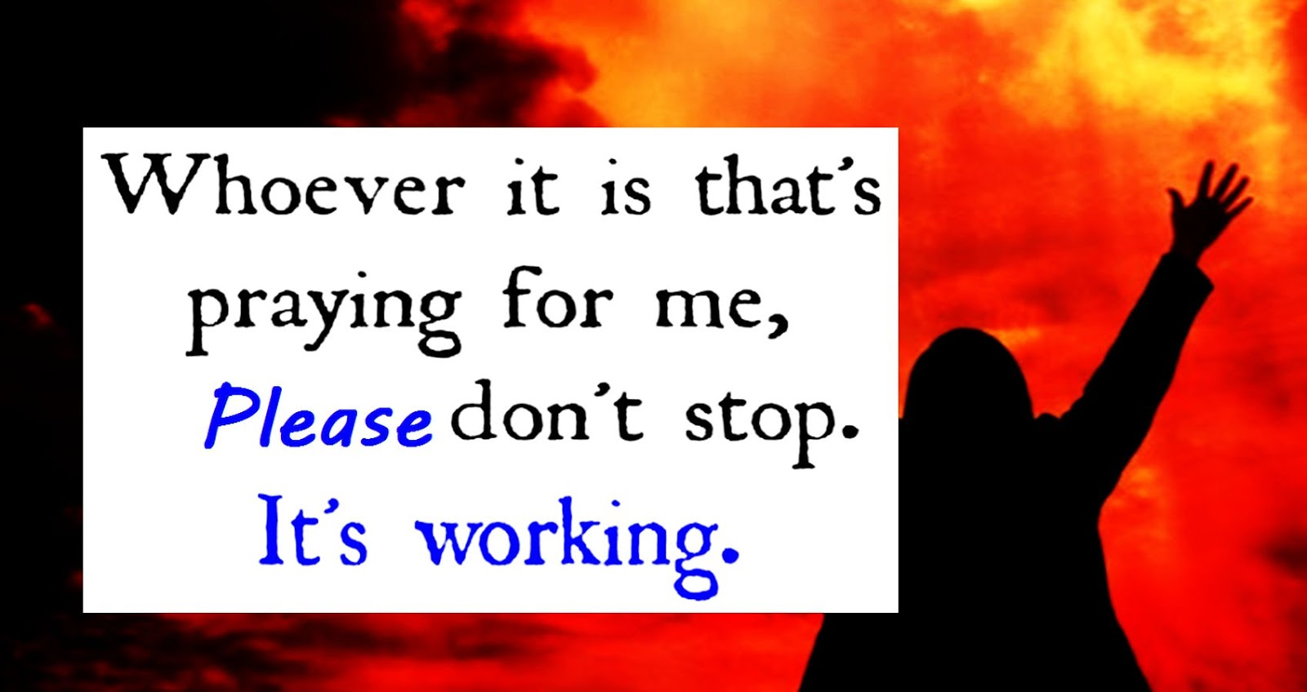
Keep Praying!

Slide 2

Thanksgiving and Prayer

Slide 3
Philippians 1:3-11
New International Version
3 I thank my God every time I remember you. 4 In all my prayers for all of you, I always pray with joy 5 because of your partnership in the gospel from the first day until now, 6 being confident of this, that he who began a good work in you will carry it on to completion until the day of Christ Jesus.

Slide 4
Philippians 1:3-11
New International Version
7 It is right for me to feel this way about all of you, since I have you in my heart and, whether I am in chains or defending and confirming the gospel, all of you share in God’s grace with me. 8 God can testify how I long for all of you with the affection of Christ Jesus.

Slide 5
Philippians 1:3-11
New International Version
9 And this is my prayer: that your love may abound more and more in knowledge and depth of insight, 10 so that you may be able to discern what is best and may be pure and blameless for the day of Christ, 11 filled with the fruit of righteousness that comes through Jesus Christ—to the glory and praise of God.

Slide 6
Ephesians 3:14-21
New International Version
14 For this reason I kneel before the Father, 15 from whom every family[a] in heaven and on earth derives its name. 16 I pray that out of his glorious riches he may strengthen you with power through his Spirit in your inner being, 17 so that Christ may dwell in your hearts through faith.

Slide 7
Ephesians 3:14-21
New International Version
And I pray that you, being rooted and established in love, 18 may have power, together with all the Lord’s holy people, to grasp how wide and long and high and deep is the love of Christ, 19 and to know this love that surpasses knowledge—that you may be filled to the measure of all the fullness of God.
.

Slide 8
Ephesians 3:14-21
New International Version
20 Now to him who is able to do immeasurably more than all we ask or imagine, according to his power that is at work within us, 21 to him be glory in the church and in Christ Jesus throughout all generations, for ever and ever! Amen.

Slide 9
Ephesians 3:14-21
Living Bible
14-15 When I think of the wisdom and scope of his plan, I fall down on my knees and pray to the Father of all the great family of God—some of them already in heaven and some down here on earth— 16 that out of his glorious, unlimited resources he will give you the mighty inner strengthening of his Holy Spirit. 17 And I pray that Christ will be more and more at home in your hearts, living within you as you trust in him.

Slide 10
Ephesians 3:14-21
Living Bible
May your roots go down deep into the soil of God’s marvelous love; 18-19 and may you be able to feel and understand, as all God’s children should, how long, how wide, how deep, and how high his love really is; and to experience this love for yourselves, though it is so great that you will never see the end of it or fully know or understand it. And so at last you will be filled up with God himself.

Slide 11
Ephesians 3:14-21
Living Bible
20 Now glory be to God, who by his mighty power at work within us is able to do far more than we would ever dare to ask or even dream of—infinitely beyond our highest prayers, desires, thoughts, or hopes. 21 May he be given glory forever and ever through endless ages because of his master plan of salvation for the Church through Jesus Christ.

Slide 12

Keep Praying!

Slide 13



Keep Praying!

Slide 14
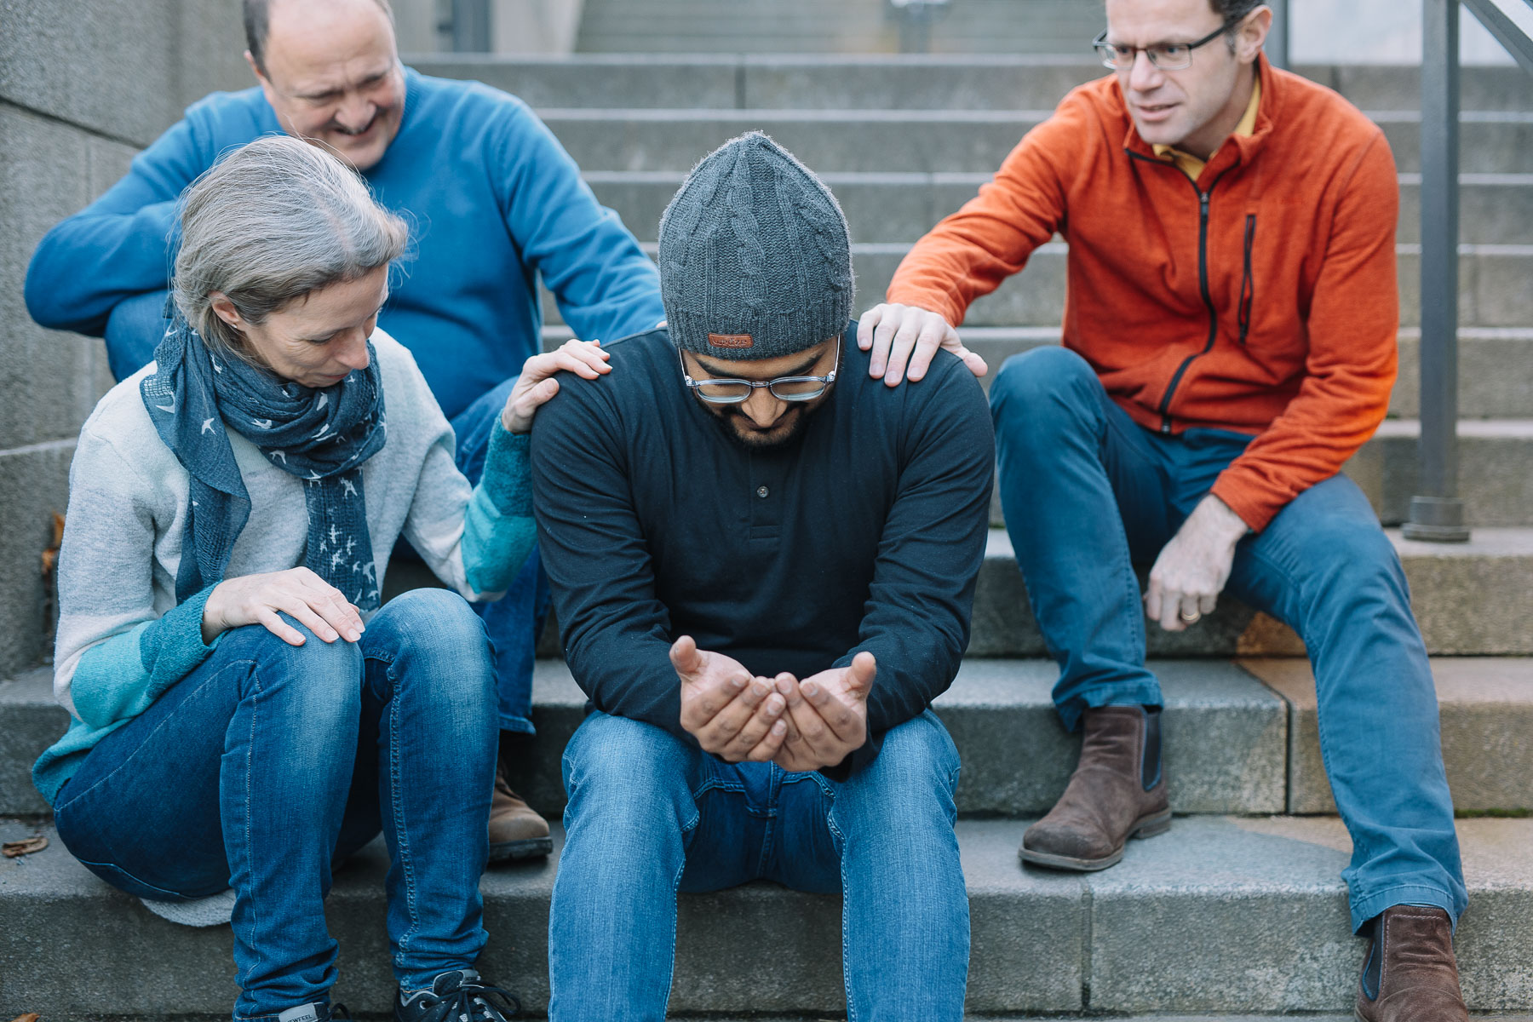
Keep Praying!

Slide 15
Keep Praying!

