Slide 1
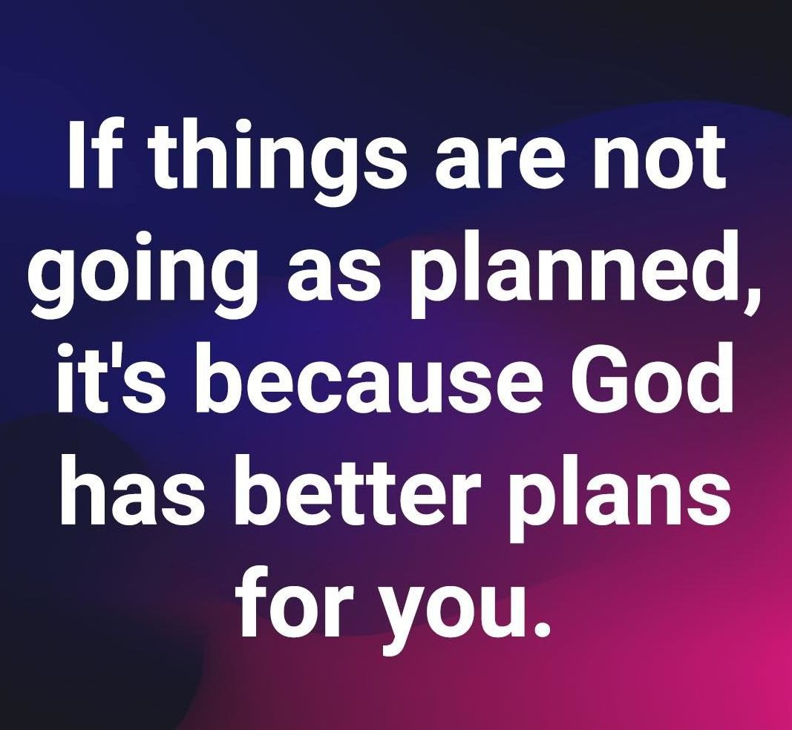
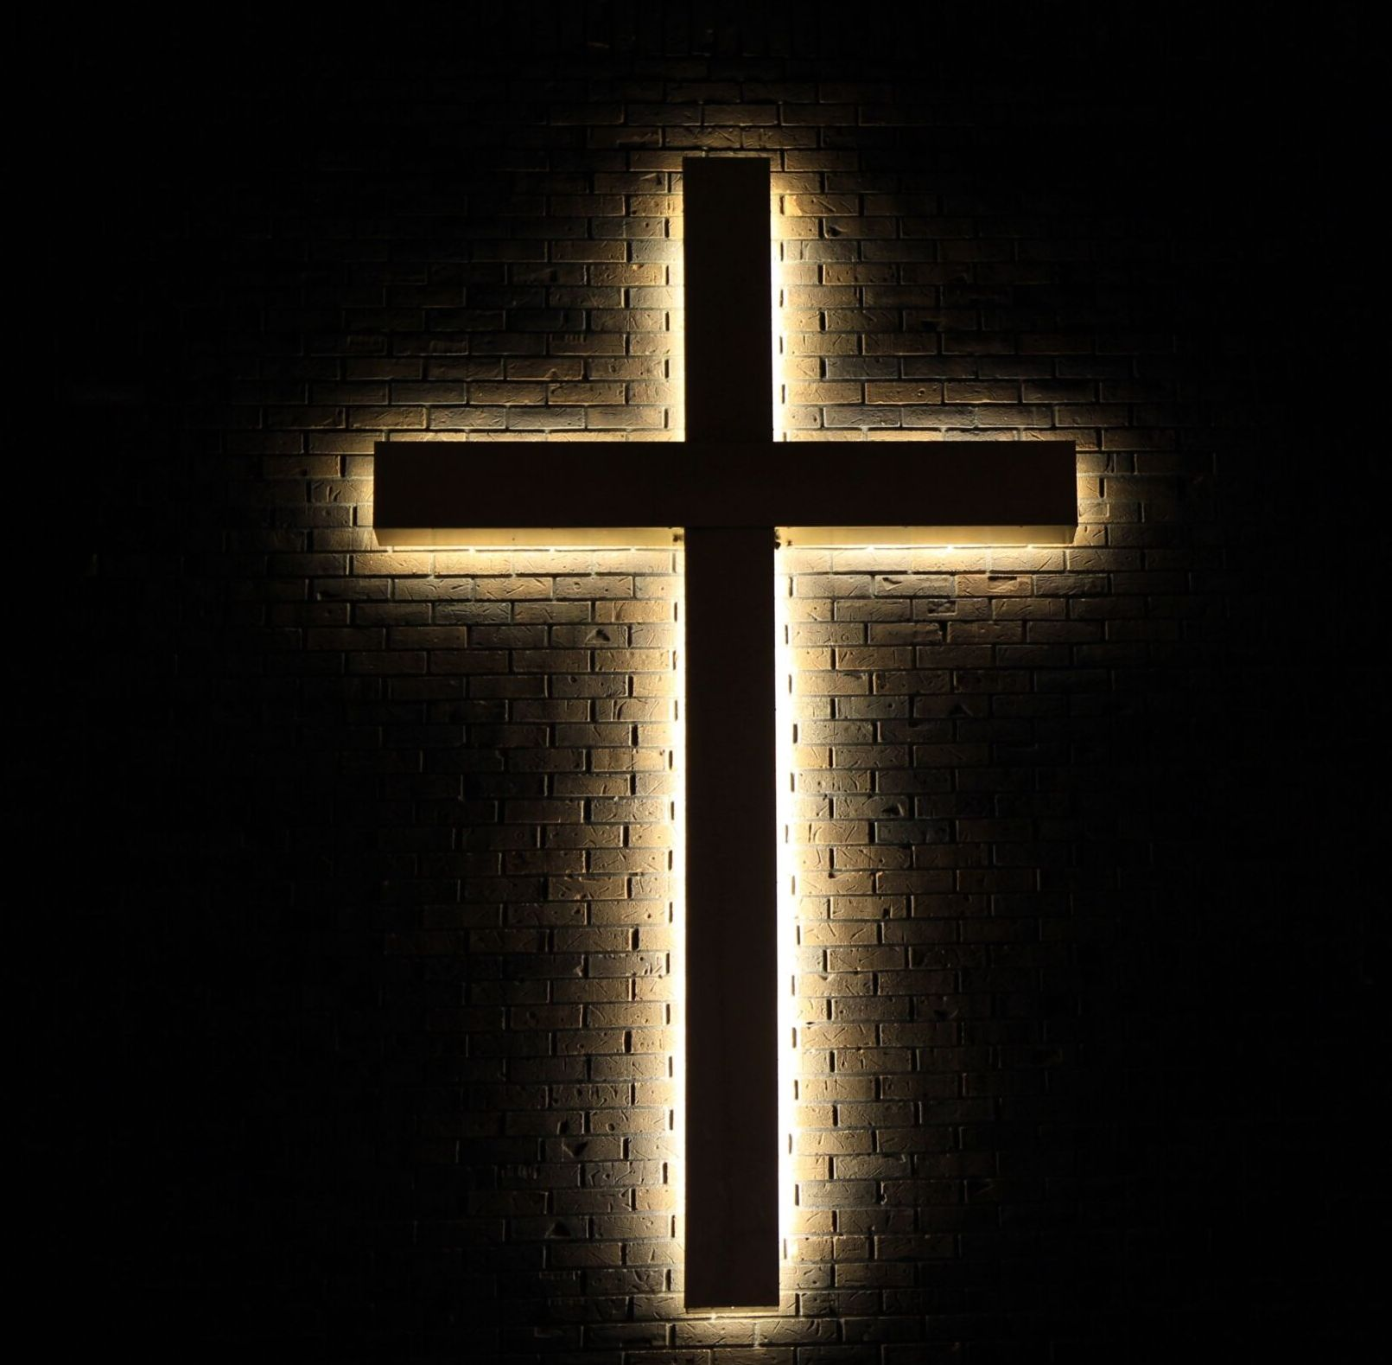
God’s Way or My Way ?
Matthew 14:22-33

Slide 2


Slide 3
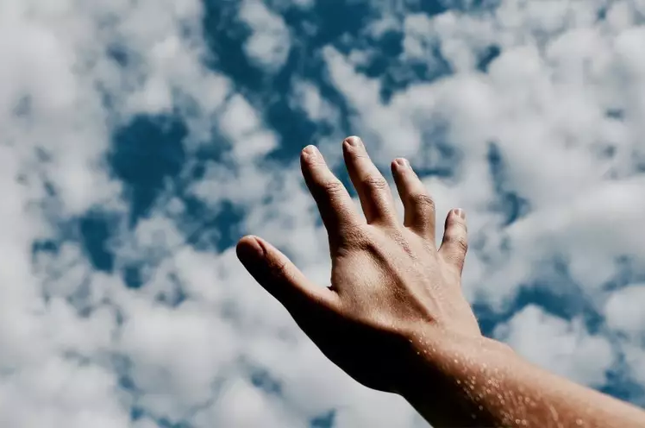

Slide 4
Isaiah 55:8-9 NIV
8 “For my thoughts are not your thoughts, neither are your ways my ways,” declares the Lord.
9 “As the heavens are higher than the earth, so are my ways higher than your ways and my thoughts than your thoughts.

Slide 5
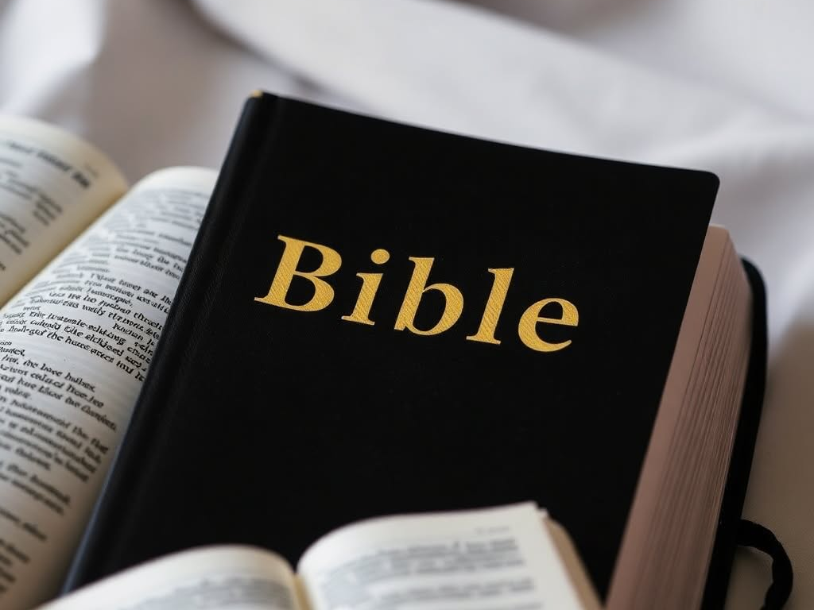
God’s Ways Are Accomplished By God’s Power

Slide 6
Acts 1:4-11 NIV
7 He said to them: “It is not for you to know the times or dates the Father has set by his own authority. 8 But you will receive power when the Holy Spirit comes on you; and you will be my witnesses in Jerusalem, and in all Judea and Samaria, and to the ends of the earth.”

Slide 7
Matthew 14:22-34 NIV
Jesus Walks on the Water
22 Immediately Jesus made the disciples get into the boat and go on ahead of him to the other side, while he dismissed the crowd. 23 After he had dismissed them, he went up on a mountainside by himself to pray. Later that night, he was there alone, 24 and the boat was already a considerable distance from land, buffeted by the waves because the wind was against it.

Slide 8
Matthew 14:22-34 NIV
25 Shortly before dawn Jesus went out to them, walking on the lake. 26 When the disciples saw him walking on the lake, they were terrified. “It’s a ghost,” they said, and cried out in fear.
27 But Jesus immediately said to them: “Take courage! It is I. Don’t be afraid.”
28 “Lord, if it’s you,” Peter replied, “tell me to come to you on the water.”
29 “Come,” he said.

Slide 9
Matthew 14:22-34 NIV
Then Peter got down out of the boat, walked on the water and came toward Jesus. 30 But when he saw the wind, he was afraid and, beginning to sink, cried out, “Lord, save me!”
31 Immediately Jesus reached out his hand and caught him. “You of little faith,” he said, “why did you doubt?”
32 And when they climbed into the boat, the wind died down. 33 Then those who were in the boat worshiped him, saying, “Truly you are the Son of God.”

Slide 10
Matthew 14:22-34 NIV
32 And when they climbed into the boat, the wind died down. 33 Then those who were in the boat worshiped him, saying, “Truly you are the Son of God.”

Slide 11

The weakness we live with…

Slide 12
What reminds you of God’s power?

Slide 13
What reminds you of God’s power working in your daily life?

Slide 14
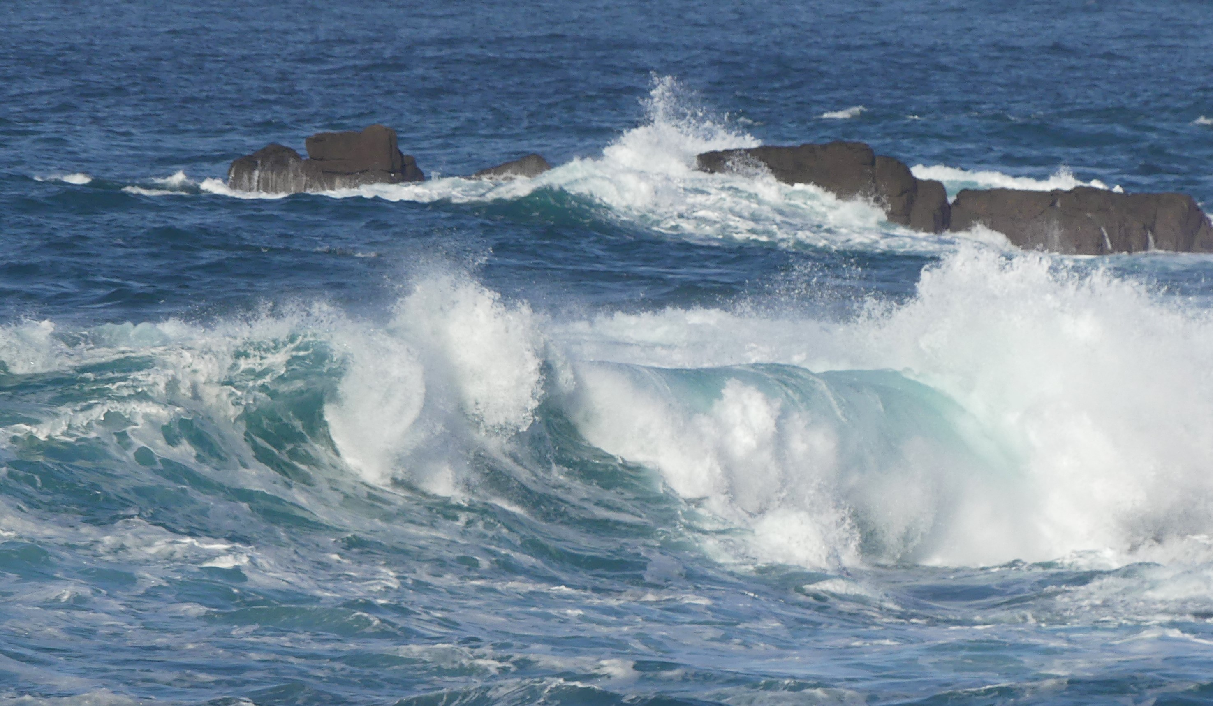
Faith
Focus
Feet

Slide 15
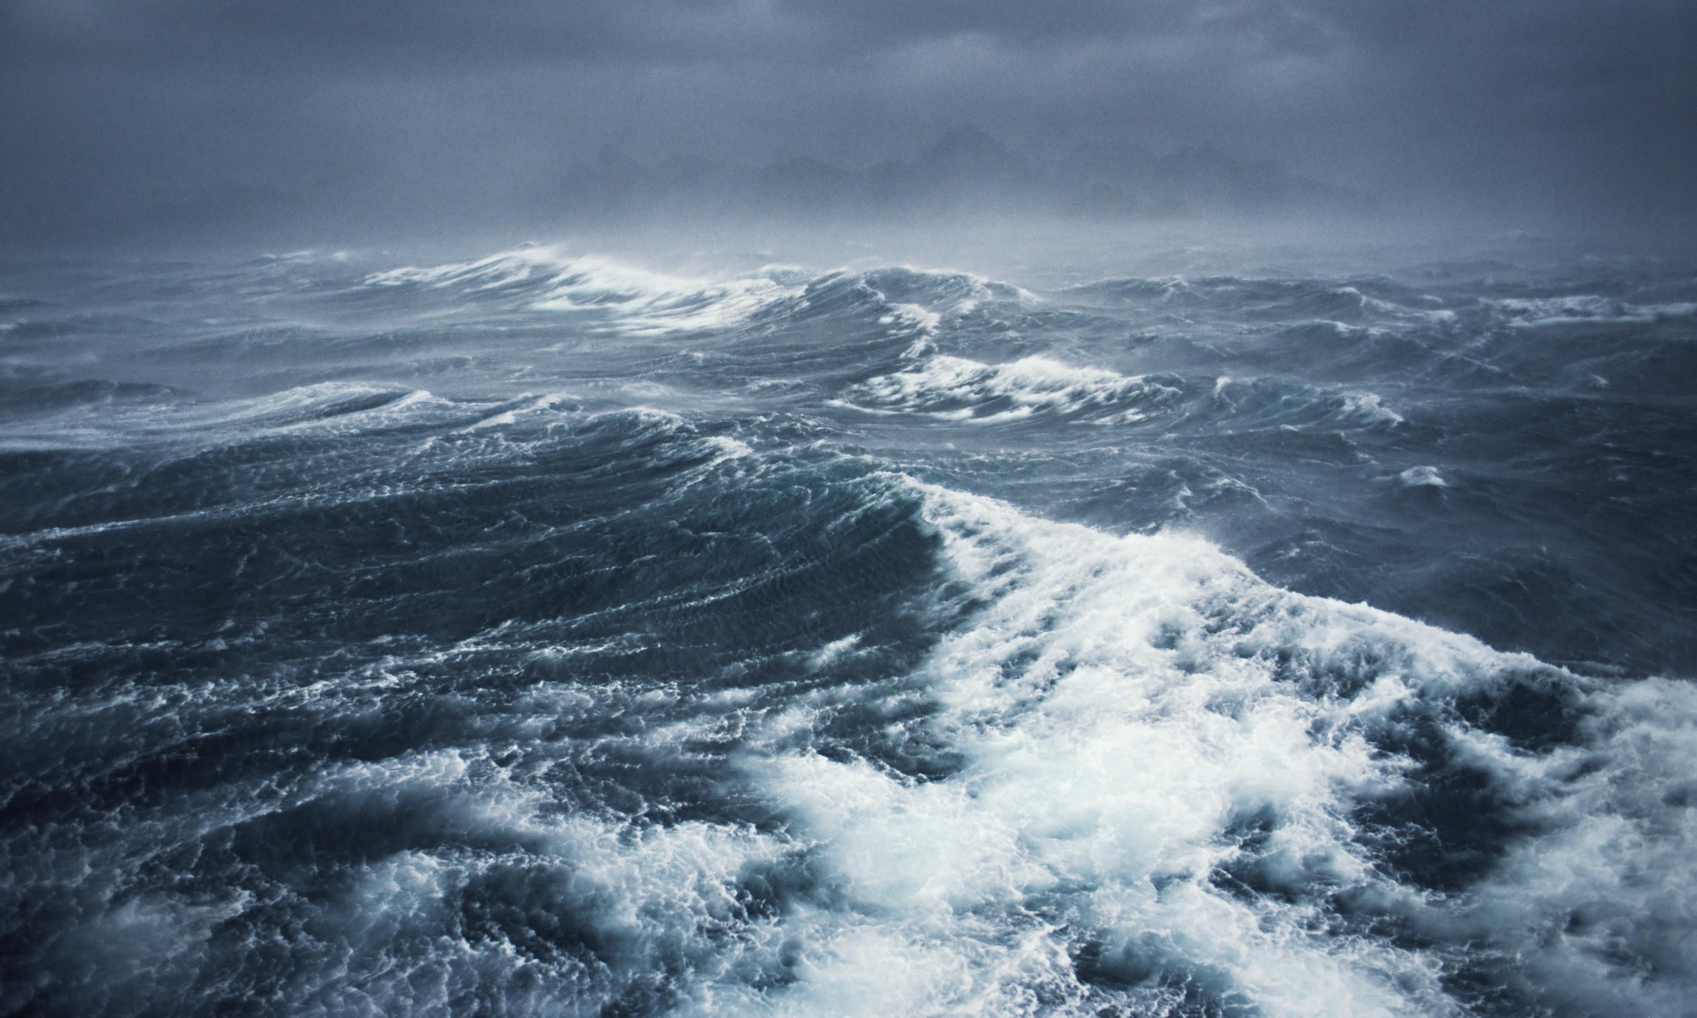
Peter walking on water teaches us the importance of where we place our faith. Even when fear and doubt come, like they did for Peter, we can trust in Jesus to sustain us through life’s storms.

Slide 16
God’s Ways Are Accomplished By God’s Power

Slide 17
God’s Way or My Way ?

Slide 18
