Slide 1


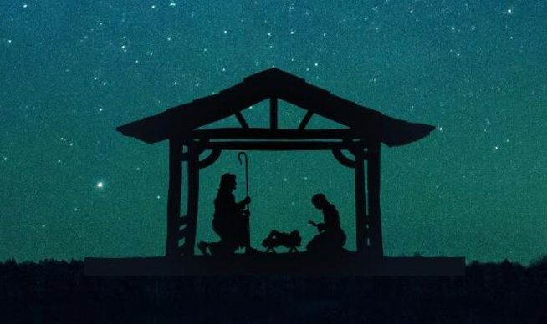
The Savior Is Here!
Galatians 4:4-7

Slide 2

Salvation has come!

Slide 3


Slide 4

What reminds you of God’s blessings?

Slide 5
What reminds you of God’s power working in your daily life?

Slide 6

God’s Ways Are Accomplished By God’s Power

Slide 7


Slide 8
Psalm 18:46
New Living Translation
46 The Lord lives! Praise to my Rock!
May the God of my salvation be exalted!

Slide 9
Psalm 85:7
New Living Translation
7 Show us your unfailing love, O Lord,
and grant us your salvation.

Slide 10
Psalm 95:1
New Living Translation
1 Come, let us sing to the Lord!
Let us shout joyfully to the Rock of our salvation.

Slide 11
Galatians 4:4-7 NIV
4 But when the set time had fully come, God sent his Son, born of a woman, born under the law, 5 to redeem those under the law, that we might receive adoption to sonship. 6 Because you are his sons, God sent the Spirit of his Son into our hearts, the Spirit who calls out, “Abba, Father.” 7 So you are no longer a slave, but God’s child; and since you are his child, God has made you also an heir.

Slide 12
Luke 2:8-15
New Living Translation
8 That night there were shepherds staying in the fields nearby, guarding their flocks of sheep. 9 Suddenly, an angel of the Lord appeared among them, and the radiance of the Lord’s glory surrounded them. They were terrified, 10 but the angel reassured them. “Don’t be afraid!” he said. “I bring you good news that will bring great joy to all people.

Slide 13
Luke 2:8-15
New Living Translation
11 The Savior—yes, the Messiah, the Lord—has been born today in Bethlehem, the city of David! 12 And you will recognize him by this sign: You will find a baby wrapped snugly in strips of cloth, lying in a manger.”
13 Suddenly, the angel was joined by a vast host of others—the armies of heaven—praising God and saying,

Slide 14
Luke 2:8-15
New Living Translation
14 “Glory to God in highest heaven,
and peace on earth to those with whom God is pleased.”
15 When the angels had returned to heaven, the shepherds said to each other, “Let’s go to Bethlehem! Let’s see this thing that has happened, which the Lord has told us about.”

Slide 15

This passage tells a great story from God’s heart

Slide 16

This is a missionary story

Slide 17

The Proclamation
The Presentation
The Purpose
The Presence

Slide 18
Galatians 4:4-7 NIV
4 But when the set time had fully come, God sent his Son, born of a woman, born under the law, 5 to redeem those under the law, that we might receive adoption to sonship. 6 Because you are his sons, God sent the Spirit of his Son into our hearts, the Spirit who calls out, “Abba, Father.” 7 So you are no longer a slave, but God’s child; and since you are his child, God has made you also an heir.

Slide 19
Colossians 3:15-17 NIV
15 Let the peace of Christ rule in your hearts, since as members of one body you were called to peace. And be thankful. 16 Let the message of Christ dwell among you richly as you teach and admonish one another with all wisdom through psalms, hymns, and songs from the Spirit, singing to God with gratitude in your hearts. 17 And whatever you do, whether in word or deed, do it all in the name of the Lord Jesus, giving thanks to God the Father through him.

Slide 20
Psalm 18:46
New Living Translation
46 The Lord lives! Praise to my Rock!
May the God of my salvation be exalted!

Slide 21
Psalm 85:7
New Living Translation
7 Show us your unfailing love, O Lord,
and grant us your salvation.

Slide 22
Psalm 95:1
New Living Translation
1 Come, let us sing to the Lord!
Let us shout joyfully to the Rock of our salvation.

