Slide 1

Who Is Jesus Christ?
21 Portraits of Christ from the book of John

Slide 2
Each chapter in the book John contains a portrayal of some aspect of the character or work of Christ
John 20:31 NIV
³¹But these are written that you may believe that Jesus is the Christ, the Son of God, and that by believing you may have life in his name.

Slide 3

What is the most important question in life?

Slide 4

Who is Jesus Christ?

Slide 5
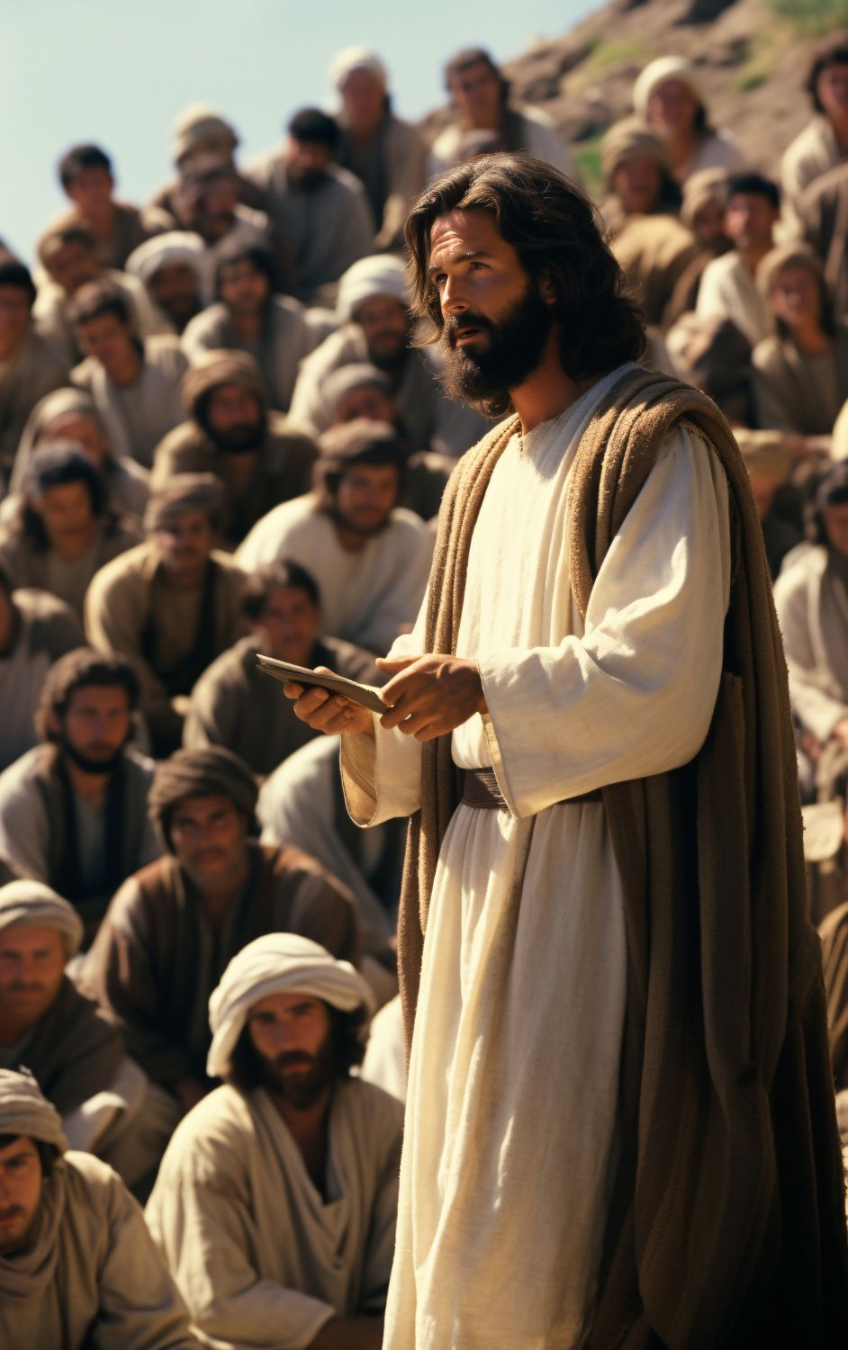
Divine Teacher
John 3:1-8
His teaching is portrayed

Slide 6
John 3:1-8 (NIV)
Jesus Teaches Nicodemus
1 Now there was a Pharisee, a man named Nicodemus who was a member of the Jewish ruling council. ² He came to Jesus at night and said, “Rabbi, we know that you are a teacher who has come from God. For no one could perform the signs you are doing if God were not with him.”

Slide 7
John 3:1-8 (NIV)
³ Jesus replied, “Very truly I tell you, no one can see the kingdom of God unless they are born again.”
⁴ “How can someone be born when they are old?” Nicodemus asked. “Surely they cannot enter a second time into their mother’s womb to be born!”

Slide 8
John 3:1-8 (NIV)
⁵ Jesus answered, “Very truly I tell you, no one can enter the kingdom of God unless they are born of water and the Spirit. ⁶ Flesh gives birth to flesh, but the Spirit gives birth to spirit.

Slide 9
John 3:1-8 (NIV)
⁷ You should not be surprised at my saying, ‘You must be born again.’ ⁸ The wind blows wherever it pleases. You hear its sound, but you cannot tell where it comes from or where it is going. So it is with everyone born of the Spirit.”

Slide 10
Divine Teacher
John 3:1-8
Life in Jesus is…
A learning experience

Slide 11
Psalm 119:33-37 NIV
33 Teach me, Lord, the way of your decrees, that I may follow it to the end.
34 Give me understanding, so that I may keep your law and obey it with all my heart.
35 Direct me in the path of your commands, for there I find delight.
36 Turn my heart toward your statutes and not toward selfish gain.
37 Turn my eyes away from worthless things; preserve my life according to your word.

Slide 12
Psalm 119:33-42 Living Bible
33-34 Just tell me what to do and I will do it, Lord. As long as I live I’ll wholeheartedly obey. 35 Make me walk along the right paths, for I know how delightful they really are. 36 Help me to prefer obedience to making money! 37 Turn me away from wanting any other plan than yours. Revive my heart toward you.

Slide 13
Psalm 119:33-42 Living Bible
38 Reassure me that your promises are for me, for I trust and revere you.
39 How I dread being mocked for obeying, for your laws are right and good. 40-42 I long to obey them! Therefore, in fairness renew my life, for this was your promise—yes, Lord, to save me! Now spare me by your kindness and your love. Then I will have an answer for those who taunt me, for I trust your promises.

Slide 14
Psalm 119:33-42 Living Bible
33-34 Just tell me what to do and I will do it, Lord. As long as I live I’ll wholeheartedly obey. 35 Make me walk along the right paths, for I know how delightful they really are.
Learning to foster obedience and love for God’s word

Slide 15

John 3:1-8
The simple lesson of Christ vs. 1-5
The main lesson of Christ vs. 3-5

Slide 16
John 3:1-21 (NIV)
Jesus Teaches Nicodemus
1 Now there was a Pharisee, a man named Nicodemus who was a member of the Jewish ruling council. ² He came to Jesus at night and said, “Rabbi, we know that you are a teacher who has come from God. For no one could perform the signs you are doing if God were not with him.”

Slide 17
John 3:1-8 (NIV)
³ Jesus replied, “Very truly I tell you, no one can see the kingdom of God unless they are born again.”
⁴ “How can someone be born when they are old?” Nicodemus asked. “Surely they cannot enter a second time into their mother’s womb to be born!”

Slide 18
John 3:1-8 (NIV)
⁵ Jesus answered, “Very truly I tell you, no one can enter the kingdom of God unless they are born of water and the Spirit. ⁶ Flesh gives birth to flesh, but the Spirit gives birth to spirit.

Slide 19
John 20:31 NIV
³¹But these are written that you may believe that Jesus is the Christ, the Son of God, and that by believing you may have life in his name.

Slide 20
John 3:1-8
The simple lesson of Christ vs. 1-5
The main lesson of Christ vs. 3-5
The heart of the matter

Slide 21
John 8:31 New Century Version
31 So Jesus said to the Jews who believed in him, “If you continue to obey my teaching, you are truly my followers.

Slide 22
John 8:31 New Life Version
31 He said to the Jews who believed, “If you keep and obey My Word, then you are My followers for sure.

Slide 23
John 8:31 New Living Translation
31 Jesus said to the people who believed in him, “You are truly my disciples if you remain faithful to my teachings.

Slide 24
Psalm 119:33-42 Living Bible
33-34 Just tell me what to do and I will do it, Lord. As long as I live I’ll wholeheartedly obey. 35 Make me walk along the right paths, for I know how delightful they really are.
Learning to foster obedience and love for God’s word

