Slide 1
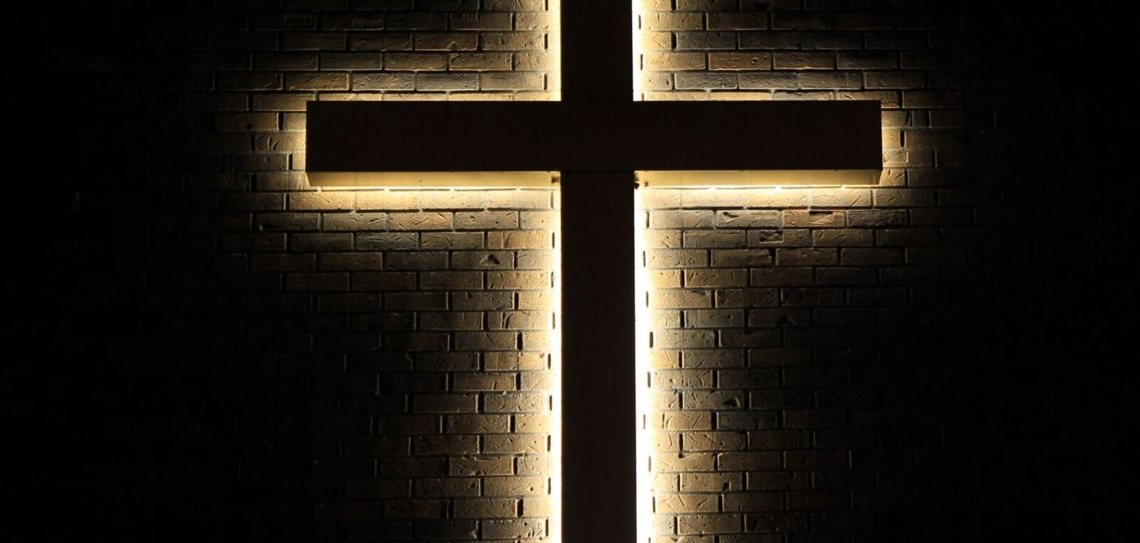


Slide 2

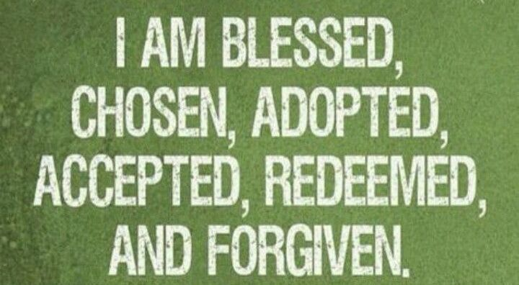

Slide 3
Romans 8:1-4 NIV
Life Through the Spirit
8 Therefore, there is now no condemnation for those who are in Christ Jesus, 2 because through Christ Jesus the law of the Spirit who gives life has set you free from the law of sin and death. 3 For what the law was powerless to do because it was weakened by the flesh, God did by sending his own Son in the likeness of sinful flesh to be a sin offering.

Slide 4
Romans 8:1-4 NIV
Life Through the Spirit
And so he condemned sin in the flesh, 4 in order that the righteous requirement of the law might be fully met in us, who do not live according to the flesh but according to the Spirit.

Slide 5
Spiritual life has come!

Slide 6
Grace and Faith!

Slide 7
Life and Purpose!

Slide 8
Power and Freedom!

Slide 9
Hope and Holiness!

Slide 10
Romans 8:14-17
New International Version
14 For those who are led by the Spirit of God are the children of God. 15 The Spirit you received does not make you slaves, so that you live in fear again; rather, the Spirit you received brought about your adoption to sonship. And by him we cry, “Abba, Father.”

Slide 11
Romans 8:14-17
New International Version
16 The Spirit himself testifies with our spirit that we are God’s children. 17 Now if we are children, then we are heirs—heirs of God and co-heirs with Christ, if indeed we share in his sufferings in order that we may also share in his glory.

Slide 12
Romans 8:14-17
New Life Version
14 All those who are led by the Holy Spirit are sons of God. 15 You should not act like people who are owned by someone. They are always afraid. Instead, the Holy Spirit makes us His sons, and we can call to Him, “My Father.” 16 For the Holy Spirit speaks to us and tells our spirit that we are children of God.

Slide 13
Romans 8:14-17
New Life Version
17 If we are children of God, we will receive everything He has promised us. We will share with Christ all the things God has given to Him. But we must share His suffering if we are to share His shining-greatness.

Slide 14

The Spirit Leads Us

Slide 15
Romans 8:14-17
New International Version
14 For those who are led by the Spirit of God are the children of God. 15 The Spirit you received does not make you slaves, so that you live in fear again; rather, the Spirit you received brought about your adoption to sonship. And by him we cry, “Abba, Father.”

Slide 16
The Spirit Frees Us

Slide 17
Romans 8:14-17
New International Version
14 For those who are led by the Spirit of God are the children of God. 15 The Spirit you received does not make you slaves, so that you live in fear again; rather, the Spirit you received brought about your adoption to sonship. And by him we cry, “Abba, Father.”

Slide 18
The Spirit Affirms Us

Slide 19
Romans 8:14-17
New International Version
16 The Spirit himself testifies with our spirit that we are God’s children. 17 Now if we are children, then we are heirs—heirs of God and co-heirs with Christ, if indeed we share in his sufferings in order that we may also share in his glory.

Slide 20
Romans 8:15-17
The Message
15-17 This resurrection life you received from God is not a timid, grave-tending life. It’s adventurously expectant, greeting God with a childlike “What’s next, Papa?” God’s Spirit touches our spirits and confirms who we really are. We know who he is, and we know who we are: Father and children.

Slide 21
Romans 8:15-17
The Message
And we know we are going to get what’s coming to us—an unbelievable inheritance! We go through exactly what Christ goes through. If we go through the hard times with him, then we’re certainly going to go through the good times with him!

Slide 22
Hope and Holiness!

