Slide 1


Slide 2


Part 10

Slide 3
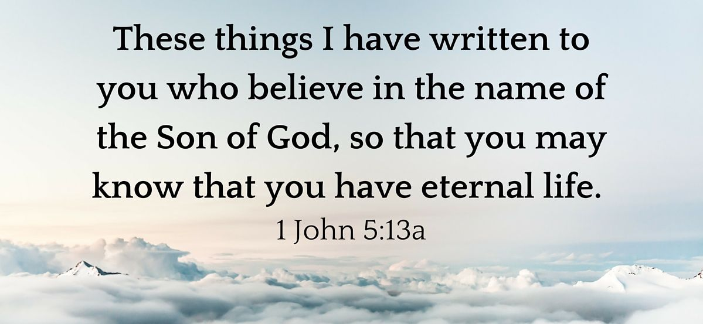

Slide 4
1 John 5:13-21 NIV
Concluding Affirmations
13 I write these things to you who believe in the name of the Son of God so that you may know that you have eternal life. 14 This is the confidence we have in approaching God: that if we ask anything according to his will, he hears us. 15 And if we know that he hears us—whatever we ask—we know that we have what we asked of him.

Slide 5
1 John 5:13-21 NIV
16 If you see any brother or sister commit a sin that does not lead to death, you should pray and God will give them life. I refer to those whose sin does not lead to death. There is a sin that leads to death. I am not saying that you should pray about that. 17 All wrongdoing is sin, and there is sin that does not lead to death.

Slide 6
1 John 5:13-21 NIV
18 We know that anyone born of God does not continue to sin; the One who was born of God keeps them safe, and the evil one cannot harm them. 19 We know that we are children of God, and that the whole world is under the control of the evil one. 20 We know also that the Son of God has come and has given us understanding, so that we may know him who is true.

Slide 7
1 John 5:13-21 NIV
And we are in him who is true by being in his Son Jesus Christ. He is the true God and eternal life.
21 Dear children, keep yourselves from idols.

Slide 8

Key Concepts
Approaching God
Everything in prayer!
Jesus first!

Slide 9
1 John 5:13-21 NIV
Concluding Affirmations
13 I write these things to you who believe in the name of the Son of God so that you may know that you have eternal life. 14 This is the confidence we have in approaching God: that if we ask anything according to his will, he hears us. 15 And if we know that he hears us—whatever we ask—we know that we have what we asked of him.

Slide 10
Ephesians 3:12
New International Version
12 In him and through faith in him we may approach God with freedom and confidence.

Slide 11
James 4:8
New International Version
8 Come near to God and he will come near to you. Wash your hands, you sinners, and purify your hearts, you double-minded.

Slide 12
Hebrews 4:16
New International Version
16 Let us then approach God’s throne of grace with confidence, so that we may receive mercy and find grace to help us in our time of need.

Slide 13
Key Concepts
Approaching God
Everything in prayer!
Jesus first!

Slide 14
1 John 5:13-21 NIV
16 If you see any brother or sister commit a sin that does not lead to death, you should pray and God will give them life. I refer to those whose sin does not lead to death. There is a sin that leads to death. I am not saying that you should pray about that. 17 All wrongdoing is sin, and there is sin that does not lead to death.

Slide 15
The concept of the sin that leads to death, as described in 1 John 5:16-17, is a sobering reminder of the seriousness of persistent, willful rejection of God’s grace. Whether understood as blasphemy against the Holy Spirit, apostasy, or persistent unrepentant sin, this sin results in spiritual death and eternal separation from God. In contrast, sins that do not lead to death can be forgiven upon genuine repentance, and believers are encouraged to intercede and support one another in overcoming sin. https://bibleask.org/sin-leads-death-john-speaks/

Slide 16
The Bible provides clear guidance on the importance of repentance, vigilance against hardening of heart, and assurance of salvation for those who remain in Christ. Believers are called to live in the light of God’s grace, continually turning to Him for forgiveness and striving to walk in obedience to His Word. Through this, they can avoid the fatal consequences of the sin that leads to death and experience the fullness of life in Christ. https://bibleask.org/sin-leads-death-john-speaks/

Slide 17
Key Concepts
Approaching God
Everything in prayer!
Jesus first!

Slide 18
1 John 5:13-21 NIV
And we are in him who is true by being in his Son Jesus Christ. He is the true God and eternal life.
21 Dear children, keep yourselves from idols.

