Slide 1


Slide 2

The resurrection…
Living the historical life

Slide 3
Ephesians 1:15-23
New International Version
15 For this reason, ever since I heard about your faith in the Lord Jesus and your love for all God’s people, 16 I have not stopped giving thanks for you, remembering you in my prayers. 17 I keep asking that the God of our Lord Jesus Christ, the glorious Father, may give you the Spirit of wisdom and revelation, so that you may know him better.

Slide 4
Ephesians 1:15-23
New International Version
18 I pray that the eyes of your heart may be enlightened in order that you may know the hope to which he has called you, the riches of his glorious inheritance in his holy people, 19 and his incomparably great power for us who believe. That power is the same as the mighty strength 20 he exerted when he raised Christ from the dead and seated him at his right hand in the heavenly realms,

Slide 5
Ephesians 1:15-23
New International Version
21 far above all rule and authority, power and dominion, and every name that is invoked, not only in the present age but also in the one to come. 22 And God placed all things under his feet and appointed him to be head over everything for the church, 23 which is his body, the fullness of him who fills everything in every way.

Slide 6
Ephesians 3:20
New International Version
20 Now to him who is able to do immeasurably more than all we ask or imagine, according to his power that is at work within us, 21 to him be glory in the church and in Christ Jesus throughout all generations, for ever and ever! Amen.

Slide 7
Ephesians 3:20-21
Living Bible
20 Now glory be to God, who by his mighty power at work within us is able to do far more than we would ever dare to ask or even dream of—infinitely beyond our highest prayers, desires, thoughts, or hopes. 21 May he be given glory forever and ever through endless ages because of his master plan of salvation for the Church through Jesus Christ.

Slide 8
Philippians 1:9-11
New International Version
9 And this is my prayer: that your love may abound more and more in knowledge and depth of insight, 10 so that you may be able to discern what is best and may be pure and blameless for the day of Christ, 11 filled with the fruit of righteousness that comes through Jesus Christ—to the glory and praise of God.

Slide 9
The resurrection…
The historical event

Slide 10
The resurrection…
a living historical event message

Slide 11
The resurrection…
Stay close to this historical event

Slide 12


Slide 13
The resurrection…
Living the historical life

Slide 14
Living the historical life…
Submit to God’s will

Slide 15
James 4:7-10
Living Bible
7 So give yourselves humbly to God. Resist the devil and he will flee from you. 8 And when you draw close to God, God will draw close to you. Wash your hands, you sinners, and let your hearts be filled with God alone to make them pure and true to him. 9 Let there be tears for the wrong things you have done.

Slide 16
James 4:7-10
Living Bible
Let there be sorrow and sincere grief. Let there be sadness instead of laughter, and gloom instead of joy. 10 Then when you realize your worthlessness before the Lord, he will lift you up, encourage and help you.

Slide 17
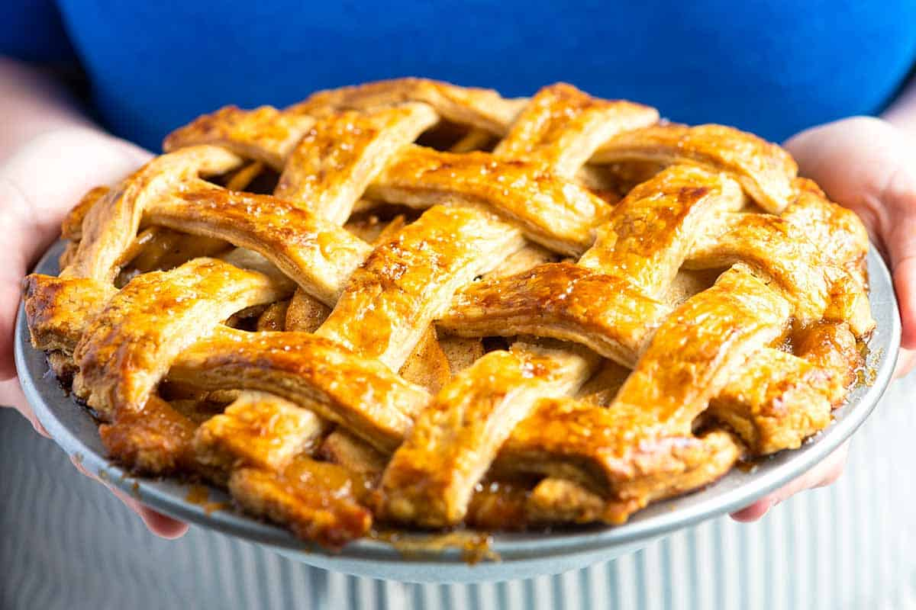
PIE IS GOOD !

Slide 18
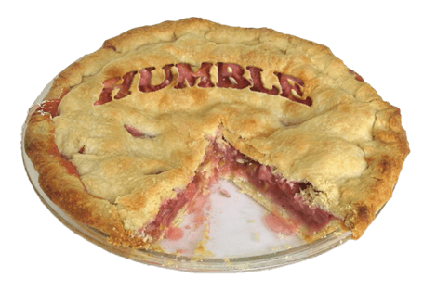
humble pie
noun
-A pie formerly made from the edible organs of a deer or hog.
-Humility, being humble.

Slide 19
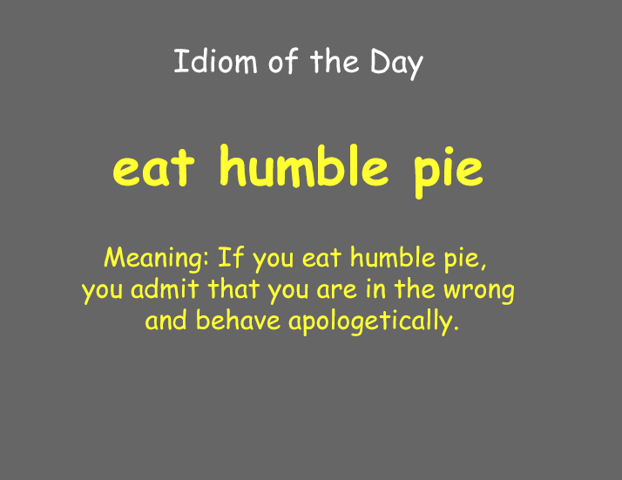

Slide 20
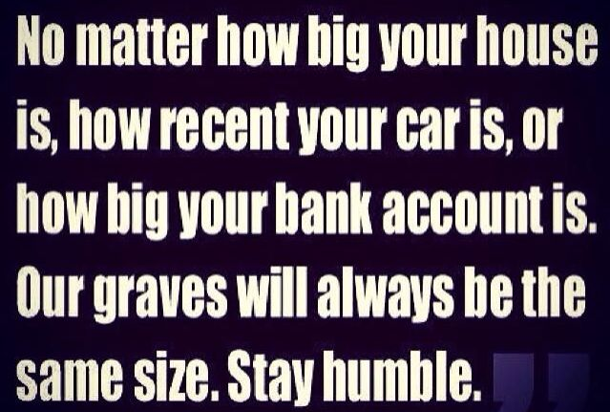

Slide 21
James 4:6
New International Version
6 But he gives us more grace. That is why Scripture says:
“God opposes the proud
but shows favor to the humble.”

Slide 22
Living the historical life…
God receives the glory!

Slide 23
Psalm 19:1
New International Version
1 The heavens declare the glory of God;
the skies proclaim the work of his hands.

Slide 24
Romans 1:20
New Century Version
20 There are things about him that people cannot see—his eternal power and all the things that make him God. But since the beginning of the world those things have been easy to understand by what God has made. So people have no excuse for the bad things they do.

Slide 25
Ephesians 3:20-21
Living Bible
20 Now glory be to God, who by his mighty power at work within us is able to do far more than we would ever dare to ask or even dream of—infinitely beyond our highest prayers, desires, thoughts, or hopes. 21 May he be given glory forever and ever through endless ages because of his master plan of salvation for the Church through Jesus Christ.

Slide 26
1 Thessalonians 2:4-8
New International Version
4 On the contrary, we speak as those approved by God to be entrusted with the gospel. We are not trying to please people but God, who tests our hearts. 5 You know we never used flattery, nor did we put on a mask to cover up greed—God is our witness. 6 We were not looking for praise from people, not from you or anyone else, even though as apostles of Christ we could have asserted our authority.

Slide 27
1 Thessalonians 2:4-8
New International Version
7 Instead, we were like young children among you.
Just as a nursing mother cares for her children, 8 so we cared for you. Because we loved you so much, we were delighted to share with you not only the gospel of God but our lives as well.

Slide 28
God Pleaser
Petra
So many choices come from those who think they know
There's a way that seems right to a man but it only brings him death
I wanna go the way that leads to life till I draw my dying breath

Slide 29
Don't wanna be a man pleaser, I wanna be a God pleaser
I just want to have the wisdom to discern the two apart
Don't wanna be a man pleaser, I wanna be a God pleaser
I just want to do the things that please the father's heart

Slide 30
Some make a sacrifice and never let it show
Some make a point of letting everybody know
Some will live their lives as unto men and they have their reward
I just wanna do everything I do, with my heart unto the Lord
Don't wanna be a man pleaser, I wanna be a God pleaser
I just want to have the wisdom to discern the two apart

Slide 31
Don't wanna be a man pleaser, I wanna be a God pleaser
I just want to have the wisdom to discern the two apart
Don't wanna be a man pleaser, I wanna be a God pleaser
I just want to do the things that please the Father's heart
I just want my life to glorify His Son

Slide 32
To make my Father proud that I'm His child before I'm done
No need to pat me on the back or stop to shake my hand
I just want to hear my Father say "Well done, well done"
I just want to hear my Father say "Well done"

Slide 33
Don't wanna be a man pleaser, I wanna be a God pleaser
I just want to have the wisdom to discern the two apart
Don't wanna be a man pleaser, I wanna be a God pleaser
I just want to do the things that please the father's heart
I wanna be a God pleaser
I wanna be a God pleaser
I wanna be a God pleaser

