Slide 1

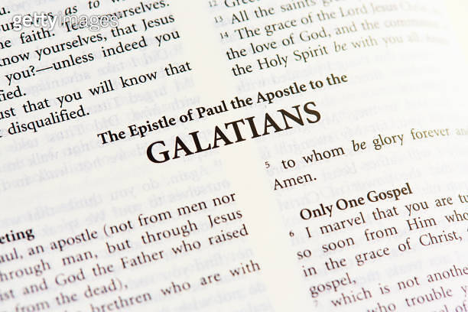
Part 1
Real Freedom In Christ

Slide 2
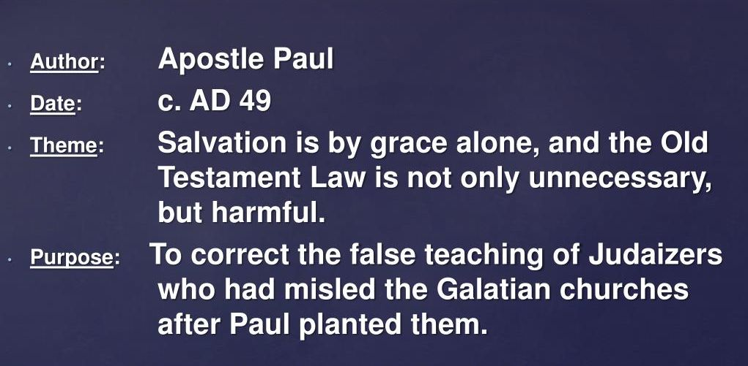

Slide 3
Galatians 5:1-6
Contemporary English Version
Christ Gives Freedom
1 Christ has set us free! This means we are really free. Now hold on to your freedom and don't ever become slaves of the Law again.
2 I, Paul, promise you that Christ won't do you any good if you get circumcised. 3 If you do, you must obey the whole Law. 4 And if you try to please God by obeying the Law, you have cut yourself off from Christ and his gift of undeserved grace.

Slide 4
Galatians 5:1-6
Contemporary English Version
Christ Gives Freedom
5 But the Spirit makes us sure God will accept us because of our faith in Christ. 6 If you are a follower of Christ Jesus, it makes no difference whether you are circumcised or not. All that matters is your faith that makes you love others.

Slide 5
Galatians 5:1-6
New Living Translation
Freedom in Christ
1 So Christ has truly set us free. Now make sure that you stay free, and don’t get tied up again in slavery to the law. 2 Listen! I, Paul, tell you this: If you are counting on circumcision to make you right with God, then Christ will be of no benefit to you. 3 I’ll say it again. If you are trying to find favor with God by being circumcised, you must obey every regulation in the whole law of Moses

Slide 6
Galatians 5:1-6
New Living Translation
Freedom in Christ
4 For if you are trying to make yourselves right with God by keeping the law, you have been cut off from Christ! You have fallen away from God’s grace.
5 But we who live by the Spirit eagerly wait to receive by faith the righteousness God has promised to us.

Slide 7
Galatians 5:1-6
New Living Translation
Freedom in Christ
6 For when we place our faith in Christ Jesus, there is no benefit in being circumcised or being uncircumcised. What is important is faith expressing itself in love.

Slide 8

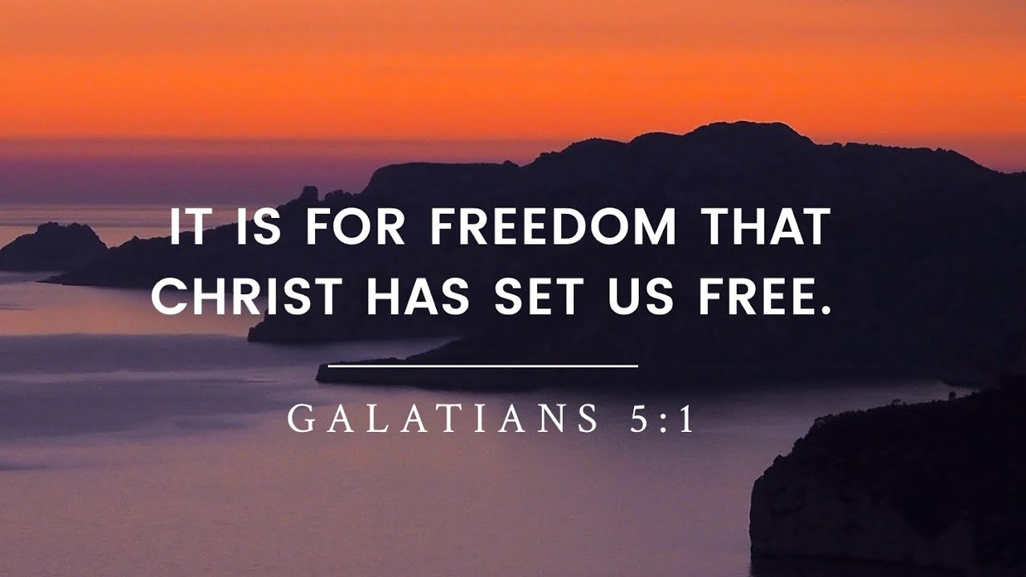

Slide 9


Slide 10
Galatians 5:1-6
New Living Translation
Freedom in Christ
4 For if you are trying to make yourselves right with God by keeping the law, you have been cut off from Christ! You have fallen away from God’s grace.
5 But we who live by the Spirit eagerly wait to receive by faith the righteousness God has promised to us.

Slide 11
Search Assist
Google
"Life in the Spirit" refers to living in accordance with the guidance and influence of the Holy Spirit, which involves a deep personal relationship with God and a commitment to spiritual growth. This concept emphasizes the importance of being led by the Spirit in daily life, fostering transformation and empowerment through faith.

Slide 12

Point #1
Who Am I In Christ?

Slide 13
Galatians 5:1-6
Contemporary English Version
Christ Gives Freedom
1 Christ has set us free! This means we are really free. Now hold on to your freedom and don't ever become slaves of the Law again.
2 I, Paul, promise you that Christ won't do you any good if you get circumcised. 3 If you do, you must obey the whole Law. 4 And if you try to please God by obeying the Law, you have cut yourself off from Christ and his gift of undeserved grace.

Slide 14
A great list!

Slide 15
In Christ you are truly free!

Slide 16
Galatians 5:1-6
New Living Translation
Freedom in Christ
4 For if you are trying to make yourselves right with God by keeping the law, you have been cut off from Christ! You have fallen away from God’s grace.
5 But we who live by the Spirit eagerly wait to receive by faith the righteousness God has promised to us.

Slide 17
Point #2
Take a stand in grace!

Slide 18
Galatians 5:1-6
Contemporary English Version
Christ Gives Freedom
1 Christ has set us free! This means we are really free. Now hold on to your freedom and don't ever become slaves of the Law again.
2 I, Paul, promise you that Christ won't do you any good if you get circumcised. 3 If you do, you must obey the whole Law. 4 And if you try to please God by obeying the Law, you have cut yourself off from Christ and his gift of undeserved grace.

Slide 19
Galatians 3:3-6
New International Version
Faith or Works of the Law
3 You foolish Galatians! Who has bewitched you? Before your very eyes Jesus Christ was clearly portrayed as crucified. 2 I would like to learn just one thing from you: Did you receive the Spirit by the works of the law, or by believing what you heard? 3 Are you so foolish? After beginning by means of the Spirit, are you now trying to finish by means of the flesh?

Slide 20
Galatians 3:3-6
New International Version
Faith or Works of the Law
4 Have you experienced so much in vain—if it really was in vain? 5 So again I ask, does God give you his Spirit and work miracles among you by the works of the law, or by your believing what you heard? 6 So also Abraham “believed God, and it was credited to him as righteousness.”

Slide 21

Point #3
Freedom allows us to express our faith in real love

Slide 22
Galatians 5:1-6
Contemporary English Version
Christ Gives Freedom
5 But the Spirit makes us sure God will accept us because of our faith in Christ. 6 If you are a follower of Christ Jesus, it makes no difference whether you are circumcised or not. All that matters is your faith that makes you love others.

Slide 23
Galatians 5:1-6
New Living Translation
Freedom in Christ
6 For when we place our faith in Christ Jesus, there is no benefit in being circumcised or being uncircumcised. What is important is faith expressing itself in love.

Slide 24
What matters?

Slide 25
Important!

Slide 26
This is the purpose of freedom

